Slide 1
How to use
Put screen shot as background then scale and crop to desired dimensions (this slide deck is 4:3)
Add monitor overlay from last set of slides along with play type and controls.
Click on controls that are not used in the game and from the tab menu click “Picture Format” and choose “Color” and then pick a color to denote not in use, for the controls that are used in the game repeat the process and pick the color of your choice (this deck uses Red to denote active controls).
When done, select all contents that are on the slide (not the text on the left side that’s off the slide itself), right click and hit S for ‘Save as Picture’ save as the name of the MAME (or whatever) filename, i.e. ddragon for “Double Dragon”. Note: Although this information is on the left side, outside the slide, it is dependent on what version ROM you’re using (i.e. 1942 vs 1942A vs 1942ABL vs 1942ITI, etc) try the default and if the image isn’t shown rename the file to match your ROM.

Slide 2
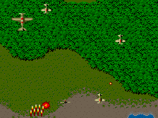





1942
Loop
Only 3 loops per plane!
GameName | Filename
1942 | 1942
Fire
Left side controls only
Eliminate all planes in red formation to reveal “POW” Fly over “POW” to obtain extra fire power Use looping action to evade enemy (only 3 loops per plane)
alt

Slide 3
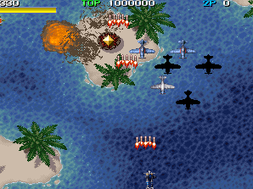





1944 The Loop Master
Fire/Charge
Bomb
GameName | Filename
1944 The Loop Master | 1944
Collect 10 to call the golden fighter
Shoot down a golden fighter to collect a side-fighter
Upgrade shot by 4 levels
Adds one extra bomb stock
Recovers durability
co-op

Slide 4
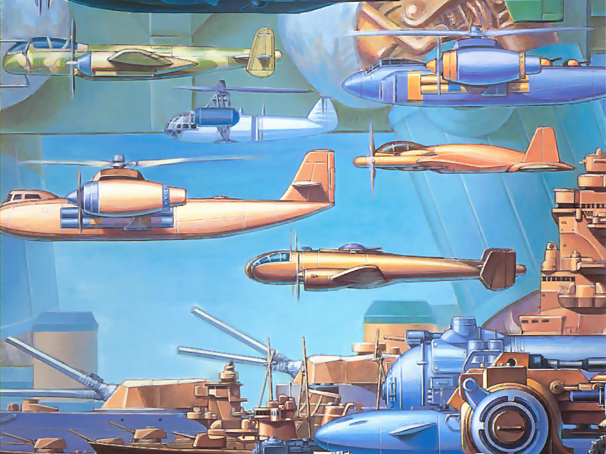
19xx the war against destiny
GameName | Filename
19xx the war against destiny | 19xx
Fire
Bomb
co-op

Slide 5
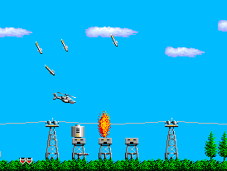
Airwolf
GameName | Filename
Airwolf | airwolf
Bomb
Fire
Left side controls only
alt

Slide 6
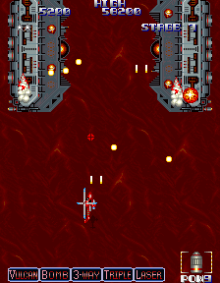






Ajax
Missile
Air enemies
Super
Gun
Ground enemies
Only 1 per life
GameName | Filename
Ajax | ajax
Left side controls only
Destroy red enemy and capture power ups:
Vulcan Rapid fire
Bomb Boosts missile
3-way Left, right & center
Triple 3 way in front
Laser Double laser
Orbital Drone assist
alt

Slide 7
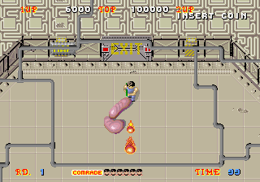
Alien Syndrome
Fire
GameName | Filename
Alien Syndrome | aliensyn
Rescue all comrades to EXIT to open for escape before time runs out Comrades not yet rescued are shown in bottom center Touching ARMAMENT item symbol allows you to use it:
F - Flamethrower
B - Napalm Bombs L - Laser O – Option followers behind to protect you R - Rapid Fire Burst
S – Standard rifle shot
? – Extra points
co-op

Slide 8
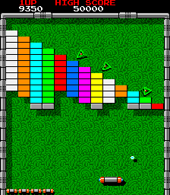
Arkanoid
GameName | Filename
Arkanoid | arkanoid
Fire/Release
alt

Slide 9
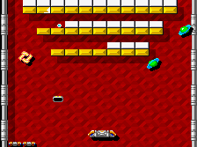
Arkanoid: Revenge of DOH
GameName | Filename
Arkanoid: Revenge of DOH | arknoid2
Fire
alt
Notes:
Graphics from https://www.emuparadise.me/

Slide 10
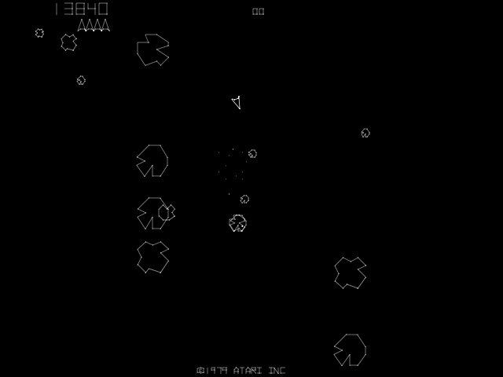
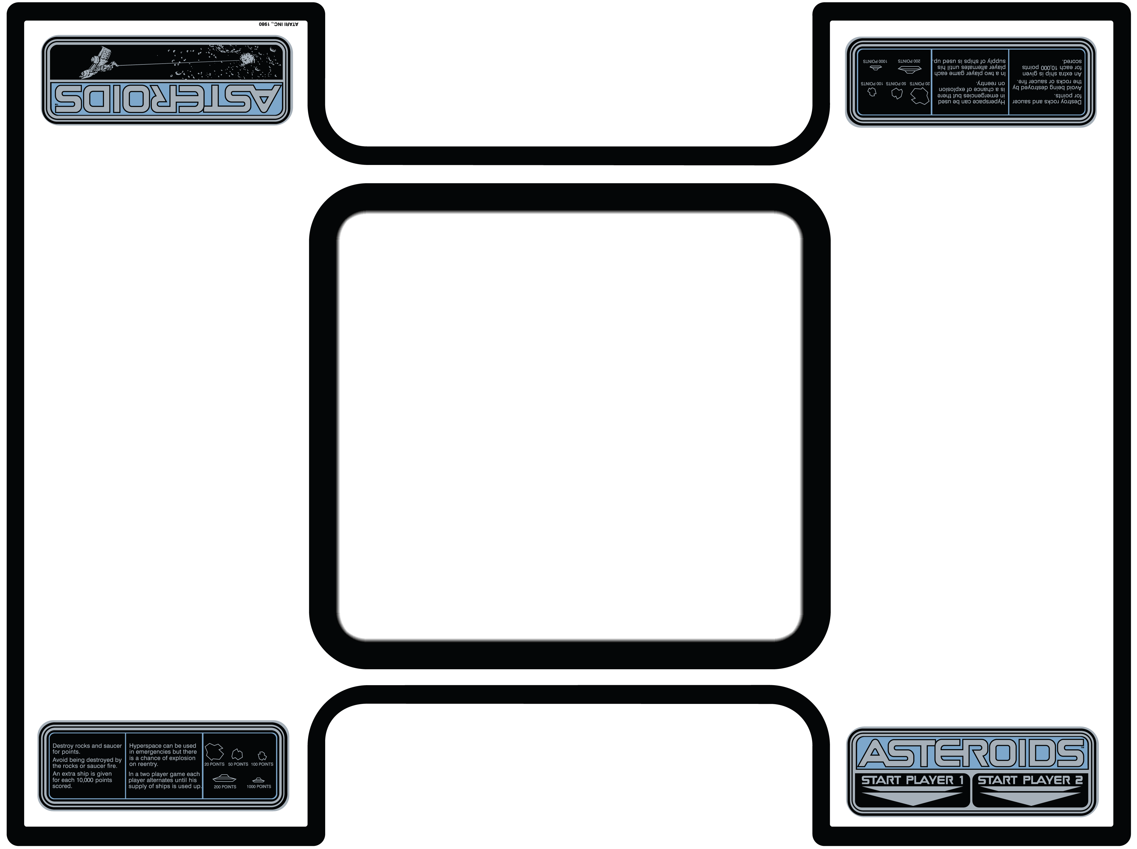
Asteroids
Hyperspace
Fire
Thrust
GameName | Filename
Asteroids | asteroid
Left
Right
alt

Slide 11
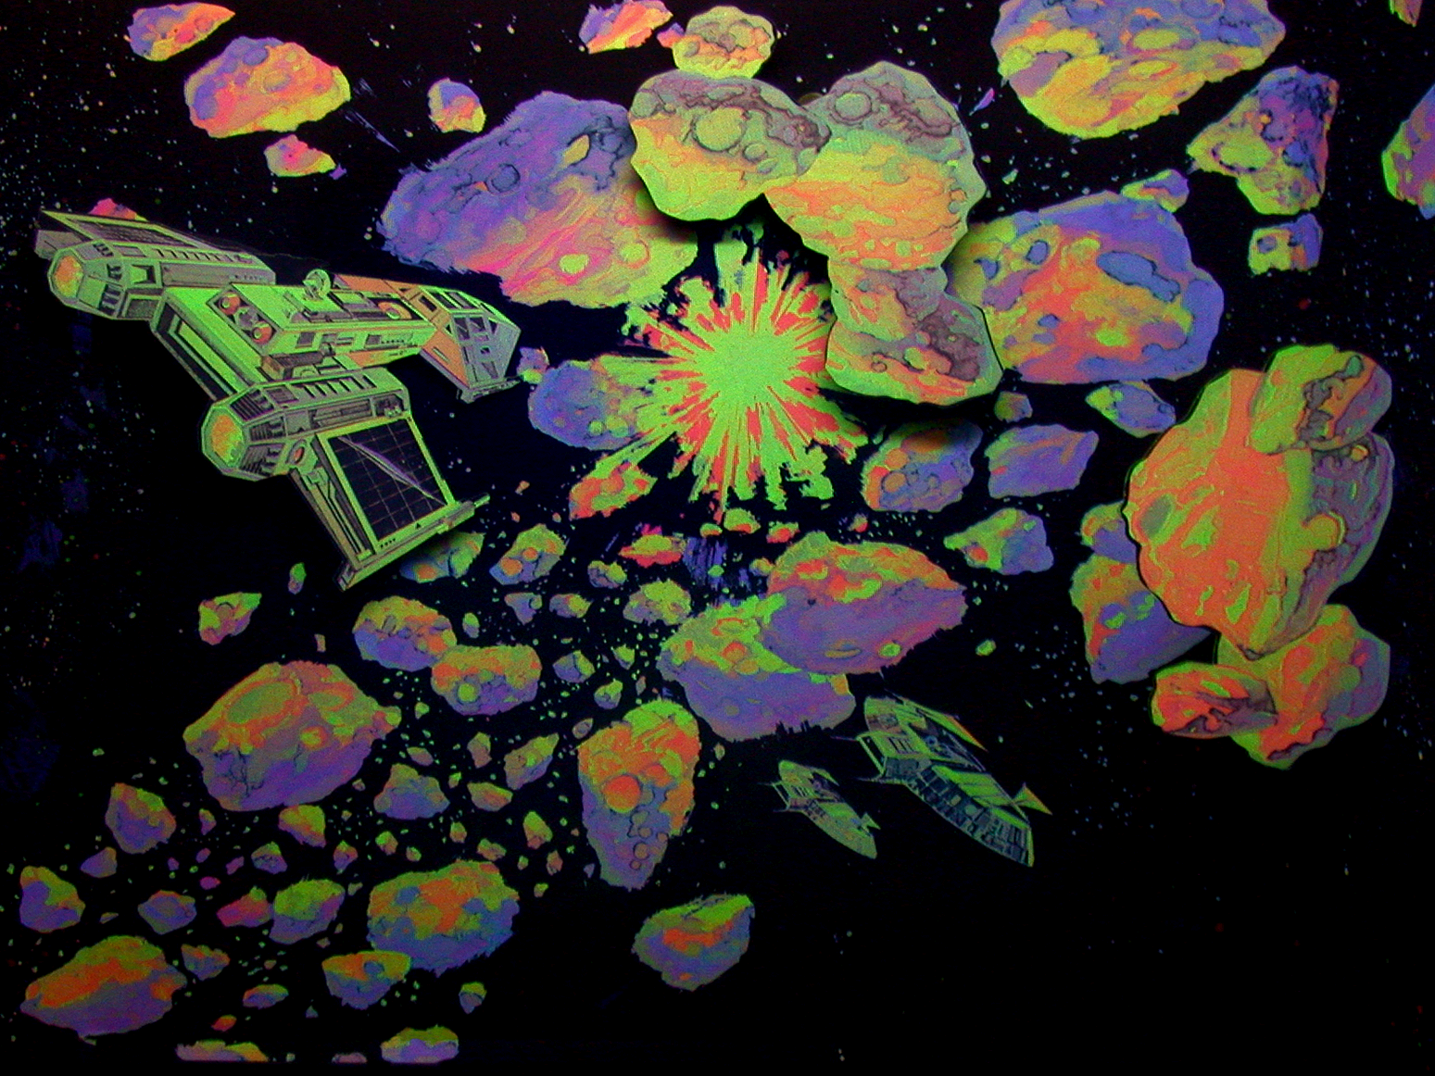
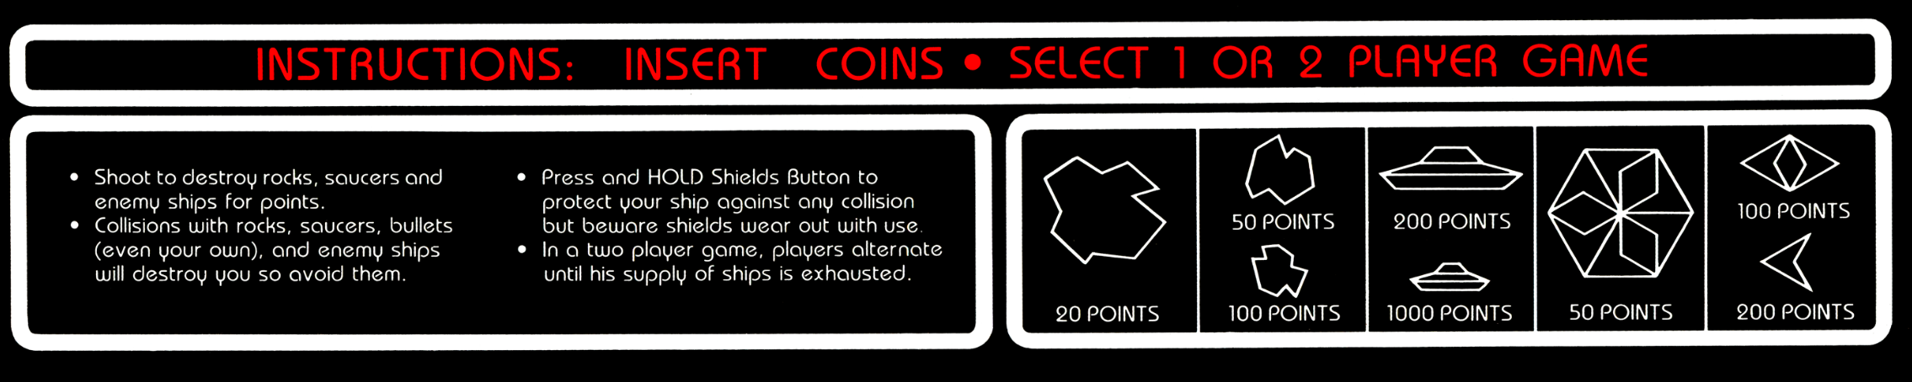
Asteroids Deluxe
GameName | Filename
Asteroids Deluxe | astdelux
Shields
Thrust
Right
Fire
Left
alt

Slide 12
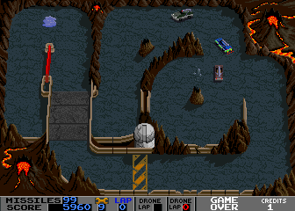
BadLands (Atari)
Accelerate
GameName | Filename
BadLands | badlands
Left
Right
Fire

Slide 13
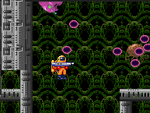
Alien Sector (aka Baraduke)
GameName | Filename
Alien Sector (aka Baraduke) | aliensec
Fire
Left side controls only
alt

Slide 14
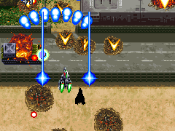
Batsugun
GameName | Filename
Batsugun | batsugunsp
Bomb
Fire
co-op

Slide 15
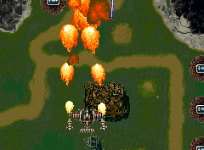
Battle Garegga
Formation
GameName | Filename
Battle Garegga | bgaregga
Bomb
Fire
co-op

Slide 16
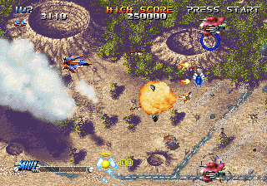
Blazing Star
Bomb
Fire
GameName | Filename
Blazing Star | blazstar
co-op

Slide 17
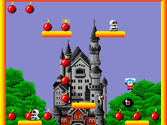
Bomb Jack
Jump
GameName | Filename
Bomb Jack | bombjack
Left side controls only
alt

Slide 18
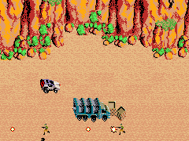
BreakThru
GameName | Filename
BreakThru | brkthru
Jump
Fire
Left side controls only
alt

Slide 19
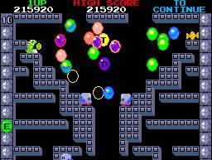
Bubble Bobble
Fire
Jump
GameName | Filename
Bubble Bobble | bublboblr
Blow bubbles at the baddies.
Pop the baddie bubbles with your horns or tail spikes
Collect the bonus
Tips:
To gain height you may jump on bubbles (even your own)
To get special powers collect charms (hearts, cross, etc.)
co-op

Slide 20
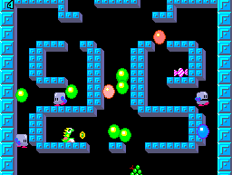
Bubble Lost Cave
GameName | Filename
Bubble Lost cave (not Symphony) | bublcave
Jump
Fire
co-op

Slide 21
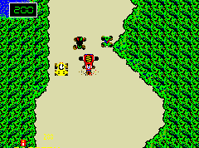
Bump 'n' Jump
GameName | Filename
Bump 'n' Jump | bnj
Jump
Left side controls only
alt

Slide 22
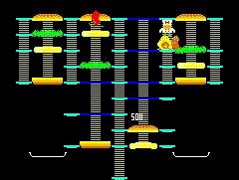
BurgerTime
Pepper
GameName | Filename
BurgerTime | btime
Left side controls only
alt

Slide 23
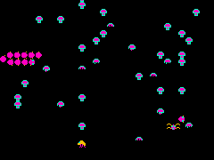

Centipede
Fire
GameName | Filename
Centipede | centiped
Left side controls only
alt

Slide 24
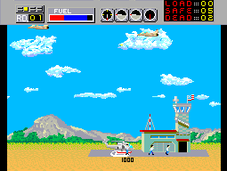
Choplifter
GameName | Filename
Choplifter | chopliftbl
Rotate
Fire
Left side controls only
alt

Slide 25
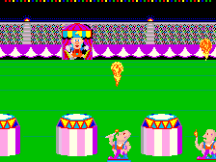
Circus Charlie
GameName | Filename
Circus Charlie | circusc
Jump
Left side controls only
alt

Slide 26
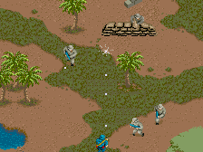
Commando (Capcom)
Grenade
GameName | Filename
Commando (Data East not Capcom) | commandou
Fire
Left side controls only
alt

Slide 27
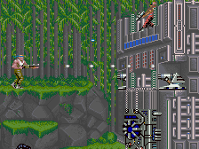
Contra
GameName | Filename
Contra | contra
Jump
Fire
co-op

Slide 28
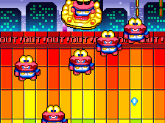
Cosmo Gang The Video
GameName | Filename
Cosmo Gang The Video | cosmogng
Fire
co-op

Slide 29
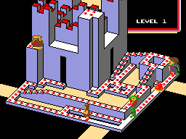
Crystal Castles
GameName | Filename
Crystal Castles | ccastles
Jump
Left side controls only
alt

Slide 30
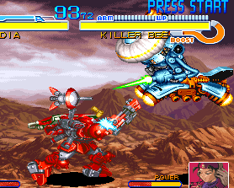
Cyberbots: Full Metal Madness
Weak Attack
Strong Attack
Boost
GameName | Filename
Cyberbots: Full Metal Madness | cybots
Weapons
VS

Slide 31
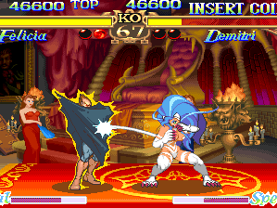
Darkstalkers: The Night Warriors
Jab
Strong
Fierce
GameName | Filename
Darkstalkers: The Night Warriors | dstlk
Punches
Kicks
Short
Forward
Roundhouse
VS

Slide 32
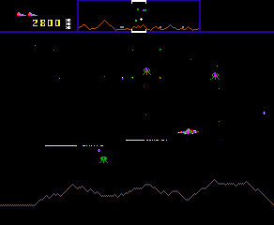
Defender
Thrust
Reverse
GameName | Filename
Defender | defender
Fire
Left side controls only
Smart Bomb
Hyperspace
alt

Slide 33
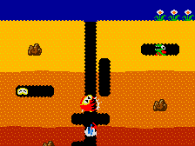
Dig Dug
GameName | Filename
Dig Dug | digdug
Pump
Left side controls only
alt

Slide 34
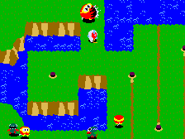
Dig Dug II
GameName | Filename
Dig Dug II | digdug2
Pump
Drill
Left side controls only
alt

Slide 35
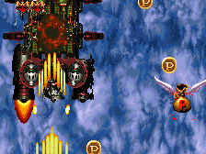
Dimahoo
GameName | Filename
Dimahoo | dimahoo
Shoot/Charge
Bomb
co-op

Slide 36
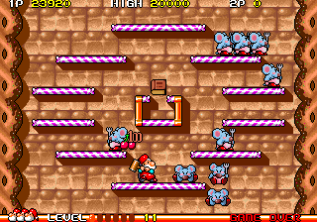
Don Doko Don
GameName | Filename
Don Doko Don | dondokod
Hammer/Throw
Jump
co-op

Slide 37
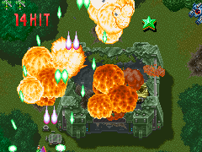
DonPachi
GameName | Filename
DonPachi | donpachi
Fire/Beam
Full-Auto
Bomb
co-op

Slide 38
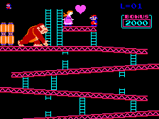
Donkey Kong
GameName | Filename
Donkey Kong | dkong
Jump
Left side controls only
alt

Slide 39
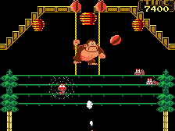
Donkey Kong 3
GameName | Filename
Donkey Kong 3 | dkong3
Fire
Left side controls only
alt

Slide 40
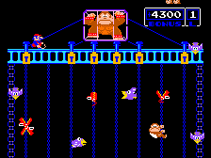
Donkey Kong Junior
GameName | Filename
Donkey Kong Junior | dkongjr
Jump
Left side controls only
alt

Slide 41
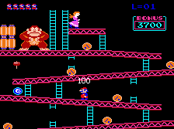
Donkey Kong II: Jumpman Returns
Jump
GameName | Filename
Donkey Kong II: Jumpman Returns | dkongx
Left side controls only
alt

Slide 42
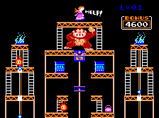
Donkey Kong II Spooky Remix
GameName | Filename
Donkey Kong II Spooky Remix | dkongx11
Jump
Fire
Left side controls only
alt

Slide 43
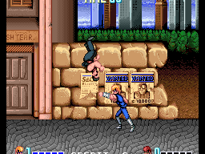
Double Dragon
Punch
Jump
Kick
GameName | Filename
Double Dragon | ddragon
JUMP KICK: Joystick in the direction. Push jump then kick.
ELBOW: Joystick in the direction. Push jump and punch buttons together.
BACK KICK: Joystick in the direction. Push jump and kick buttons together.
HEAD BUTT: Joystick in the direction. (TWICE)
BODY THROW: Joystick in the direction. Push jump button after catching enemy.
BREAK ENEMY'S HOLD: Push jump button only.
co-op

Slide 44
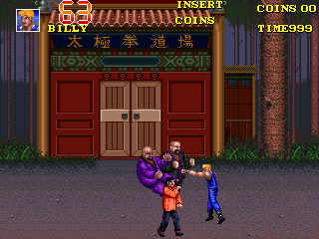
Double Dragon 3: The Rosetta Stone
GameName | Filename
Double Dragon 3: The Rosetta Stone | ddragon3
Punch
Jump
Kick
Dash
Dash
co-op

Slide 45
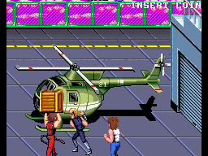
Double Dragon II: The Revenge
GameName | Filename
Double Dragon II: The Revenge | ddragon2
Attack Left
Attack Right
Jump
co-op

Slide 46
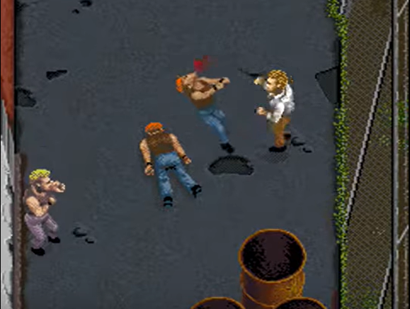
DownTown
GameName | Filename
DownTown | downtownj
Punch
Kick
co-op

Slide 47
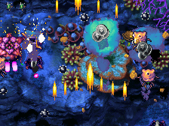
Dragon Blaze
GameName | Filename
Dragon Blaze | dragnblz
Fire/Multi-shot
Dragon Bomb
Dragon Shoot
co-op

Slide 48
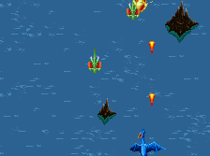
Dragon Saber
GameName | Filename
Dragon Saber | dsaber
Shoot/Charge
Bomb
co-op

Slide 49
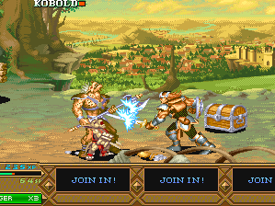
Dungeons & Dragons: Tower of Doom
Choose Magic
GameName | Filename
Dungeons & Dragons: Tower of Doom | ddtod
Attack
Jump
Use Magic
co-op

Slide 50

Fever S.O.S.
GameName | Filename
Fever S.O.S. | feversos
Shoot
Bomb
co-op

Slide 51

Final Fight
Jump
Fight
GameName | Filename
Final Fight | ffight
co-op

Slide 52

Frogger
GameName | Filename
Frogger | frogger
Left side controls only
alt

Slide 53

Galaga
Fire
GameName | Filename
Galaga | galaga
Left side controls only
alt

Slide 54

Galaga '88
Fire
GameName | Filename
Galaga '88 | galaga88
Left side controls only
alt

Slide 55

Galaxian
Fire
GameName | Filename
Galaxian | galaxian
Left side controls only
alt

Slide 56

Garou: Mark of the Wolves
Weak punch
Strong punch
Weak kick
GameName | Filename
Garou: Mark of the Wolves | garou
Strong kick
VS

Slide 57

Gauntlet
GameName | Filename
Gauntlet | gauntlet2p
Magic
Fire
co-op

Slide 58

Gauntlet II
GameName | Filename
Gauntlet II | gaunt22p
Magic
Fire
co-op

Slide 59

Ghost Pilots
GameName | Filename
Ghost Pilots | gpilots
Special Weapon
Shoot
co-op

Slide 60

Ghosts'n Goblins
GameName | Filename
Ghosts'n Goblins | gng
Jump
Fire
Left side controls only
alt

Slide 61

Ghouls'n Ghosts
GameName | Filename
Ghouls'n Ghosts | ghoulsu
Attack
Jump
Left side controls only
alt

Slide 62

Ghox
GameName | Filename
Ghox | ghoxj
Fire
co-op

Slide 63

Giga Wing
GameName | Filename
Giga Wing | gigawing
Bomb
Fire
Left side controls only
co-op

Slide 64

Golden Axe
Jump
Attack
Magic
GameName | Filename
Golden Axe | goldnaxe
Each character has a special attack move that is activated by pressing both JUMP and ATTACK at the same time. Also, double-tapping the joystick right or left will make the character charge and smash into opponents. At certain points during the game, players will come across enemies riding creatures (such as dragons). If the player knocks the original rider from the saddle, the created can be mounted and used against the enemy.
co-op

Slide 65

Golden Tee 2K
GameName | Filename
Golden Tee 2K | gt2k
Face left
Face right
Left side controls only
alt

Slide 66

Golden Tee '99
Face left
Face right
GameName | Filename
Golden Tee '99 | gt99
Left side controls only
alt

Slide 67

Gradius
GameName | Filename
Gradius | gradius
Power-up
Fire
Bomb
Left side controls only
alt

Slide 68

Vulcan Venture
GameName | Filename
Gradius II (aka Vulcan Venture) | gradius2
Select
Missile
Fire
Left side controls only
alt

Slide 69

Gradius III
GameName | Filename
Gradius III | gradius3
Select
Missile
Fire
Left side controls only
alt

Slide 70

Gradius IV: Fukkatsu
GameName | Filename
Gradius IV: Fukkatsu | gradius4
Power
Shoot
Missile
Left side controls only
alt

Slide 71

Rush'n Attack
GameName | Filename
Green Beret (aka Rush'n Attack) | gberet
Special
Knife
Left side controls only
alt

Slide 72

Gunbarich
Fire
GameName | Filename
Gunbarich | gnbarich
You miss if you run out of time or drop the puck. You can use the flipper to shoot back enemy bullets as well as the puck. The enemy bullets you shoot back can cause massive damage if you hit an enemy character. You can also control the activation of the puck and enemy bullets hit by the flipper with left and right inputs
solo

Slide 73

Gunbird 2
GameName | Filename
Gunbird 2 | gunbird2
Bomb
Fire
co-op

Slide 74

Gundhara
GameName | Filename
Gundhara | gundhara
Hand-to-hand
Grenade
Fire
Left side controls only
co-op

Slide 75

Guwange
GameName | Filename
Guwange | guwange
Shoot / Spirit
Auto fire
Bomb
co-op

Slide 76

Gyruss
GameName | Filename
Gyruss | gyruss
Fire
Left side controls only
alt

Slide 77

Hyper Sports
Controls might not be mapped correctly
G0 (right)
GameName | Filename
Hyper Sports | hyperspt
Up
Go (left)
Note: Test these controls
VS

Slide 78

Hyper Street Fighter II: The Anniversary Edition
Jab
Strong
Fierce
GameName | Filename
Hyper Street Fighter II: The Anniversary Edition | hsf2
Punches
Kicks
Short
Forward
Roundhouse
VS

Slide 79

Ikari III: The Rescue
GameName | Filename
Ikari III: The Rescue | ikari3
Kick
Punch
Jump
Note – Uses weird joystick, test this
co-op

Slide 80

Ikari Warriors
GameName | Filename
Ikari Warriors | ikari
Fire
Jump
Fire
Note– Uses weird joystick, test this
Left side controls only
Fire
co-op

Slide 81


Image Fight
Speed Change
GameName | Filename
Image Fight | imgfight
Fire
Note: Has 4 buttons, what do the other two do?
Left side controls only
This has pods or forepart in it… shoot it
You can also use the tail jets to attack
Red pods can fire in multiple directions
Blue pods can fire only forward
With red and blue pods equipped, press both buttons for special
alt

Slide 82

In the Hunt
Missile/Depth Charge
GameName | Filename
In the Hunt | inthunt
Torpedo
co-op

Slide 83

Jail Break
Weapon select
GameName | Filename
Jail Break | jailbrek
Fire
Left side controls only
alt

Slide 84

Joe & Mac Returns
Jump
Club
GameName | Filename
Joe & Mac Returns | joemacr
co-op

Slide 85

JoJo's Bizarre Adventure: Heritage for the Future
hold
Medium Attack
Light Attack
Heavy Attack
Float
Normal Jump
GameName | Filename
JoJo's Bizarre Adventure: Heritage for the Future | jojoban
Move back/Guard
Move forward
A1
A2
A3
Back-step
Dash
S
Crouch
Stand
As you rotate the joystick quarter circle back/forward, from down to left or right try hitting some of the buttons. Same with a half circle from left or right to opposite direction. You can also move the joystick in a full circle.
VS

Slide 86

Jojo’s venture
hold
Big Jump
Medium Jump
Medium Attack
Double Jump - (only in Stand Mode)
Light Attack
Heavy Attack
Normal Jump
GameName | Filename
Jojo’s venture | jojon
Move back/Guard
Move forward
A1
A2
A3
Back-step
Dash
S
Crouch
Stand
Some combos use any combination of the “A” buttons. I.E.: Press any 2 Attack buttons when your character is knocked into the air for an air recovery. This is used to get out of air-juggle combos. You may also make use of the Joystick to control the direction which you would like to recover.
co-op

Slide 87

Joust
Flap
GameName | Filename
Joust | joust
Left
Right
co-op

Slide 88

Joust 2: Survival of the Fittest
Transform
Flap
Left
Right
GameName | Filename
Joust 2: Survival of the Fittest | joust2
co-op

Slide 89

Jr. Pac-man
GameName | Filename
Jr. Pac-man | jrpacman
alt

Slide 90

Judge Dredd
GameName | Filename
Judge Dredd | jdreddp
Note – Uses guns Need to test
co-op

Slide 91

Jungle King
Jump/Knife
GameName | Filename
Jungle King | junglek
Left side controls only
alt

Slide 92

Juno First
GameName | Filename
Juno First | junofrst
Fire
Warp
Left side controls only
alt

Slide 93

Far East of Eden: Kabuki Klash
Medium attack
Weak attack
Weak kick
GameName | Filename
Far East of Eden: Kabuki Klash | kabukikl
Medium kick
VS

Slide 94

Kangaroo
GameName | Filename
Kangaroo | kangaroo
Punch
Left side controls only
alt

Slide 95

Kicker
Kick
Jump
GameName | Filename
Kicker | kicker
Left side controls only
alt

Slide 96

Killer Instinct
GameName | Filename
Killer Instinct | kinst
Medium
Quick
Fierce
Punches
Kicks
Quick
Medium
Fierce
VS

Slide 97

Killer Instinct 2
GameName | Filename
Killer Instinct 2 | kinst2
Medium
Quick
Fierce
Punches
Kicks
Quick
Medium
Fierce
VS

Slide 98

The King of Fighters 2000
Weak punch
Strong punch
Weak kick
GameName | Filename
The King of Fighters 2000 | kof2000
Strong kick
VS

Slide 99

The King of Fighters 2001
Weak punch
Strong punch
Weak kick
GameName | Filename
The King of Fighters 2001 | kof2001
Strong kick
co-op

Slide 100

The King of Fighters 2002
Weak punch
Strong punch
Weak kick
GameName | Filename
The King of Fighters 2002 | kof2002
Strong kick
co-op

Slide 101

The King of Fighters 2003
Weak punch
Strong punch
Weak kick
GameName | Filename
The King of Fighters 2003 | kof2003
Strong kick
co-op

Slide 102

The King of Fighters ‘94
Weak punch
Strong punch
Weak kick
GameName | Filename
The King of Fighters '94 | kof94
Strong kick
VS

Slide 103

The King of Fighters ‘95
Weak punch
Strong punch
Weak kick
GameName | Filename
The King of Fighters '95 | kof95
Strong kick
VS

Slide 104

The King of Fighters ‘96
Weak punch
Strong punch
Weak kick
GameName | Filename
The King of Fighters '96 | kof96
Strong kick
VS

Slide 105

The King of Fighters ‘97
Weak punch
Strong punch
Weak kick
GameName | Filename
The King of Fighters '97 | kof97
Strong kick
VS

Slide 106

The King of Fighters ’98 The Slugfest
Weak punch
Strong punch
Weak kick
GameName | Filename
The King of Fighters '98: The Slugfest | kof98
Strong kick
VS

Slide 107

The King of Fighters '99: Millennium Battle
Weak punch
Strong punch
Weak kick
GameName | Filename
The King of Fighters '99: Millennium Battle | kof99
Strong kick
VS

Slide 108

Kingdom Grand Prix
Accelerate
GameName | Filename
Kingdom Grand Prix | kingdmgp
Fire
Bomb
co-op

Slide 109

Kizuna Encounter: Super Tag Battle
Weapon
Punch
Kick
GameName | Filename
Kizuna Encounter: Super Tag Battle | kizuna
Tag
VS

Slide 110

Klax
Flip
GameName | Filename
Klax | klax
co-op

Slide 111

The Last Blade 2
Weak Slash
Strong Slash
GameName | Filename
The Last Blade 2 | lastbld2
Kick
A
B
C
D
Repel
VS

Slide 112

The Last Blade
Weak Slash
Strong Slash
GameName | Filename
The Last Blade | lastblad
Kick
A
B
C
D
Repel
VS

Slide 113

League Bowling
Set Controls & Set Power
GameName | Filename
League Bowling | lbowling
VS

Slide 114

The Legend of Kage
Attack
Jump
GameName | Filename
The Legend of Kage | lkage
Left side controls only
alt

Slide 115

Lode Runner: The Dig Fight
GameName | Filename
Lode Runner: The Dig Fight | loderndf
Dig /Fill Right
Dig/Fill Left
Redo
co-op

Slide 116

Magic Sword
Attack
Jump
GameName | Filename
Magic Sword | msword
co-op

Slide 117

Magical Drop III
GameName | Filename
Magical Drop III | magdrop3
Shift the balloons a line down
Catch Balloons
Throw Balloons
Left
Right
VS

Slide 118

Major Havoc
GameName | Filename
Major Havoc | mhavoc
Jump/Fire
Shield
Left side controls only
alt

Slide 119

Make Trax
GameName | Filename
Make Trax | maketrxb
Left side controls only
alt

Slide 120

Mappy
Door Open/Close
GameName | Filename
Mappy | mappy
Left
Right
Left side controls only
alt

Slide 121

Marble Madness
GameName | Filename
Marble Madness | marble
While this game can support 2 simultaneous players, there’s only one trackball so only use 1 player mode
co-op

Slide 122

Mario Bros.
Jump
GameName | Filename
Mario Bros. | mario
Right
Left
Note: Unlike other Mario games, players cannot jump on enemies and squash them, unless they were already turned on their back.
Either
VS
co-op

Slide 123

Mars Matrix: Hyper Solid Shooting
Fire
Bomb
GameName | Filename
Mars Matrix: Hyper Solid Shooting | mmatrix
co-op

Slide 124

Marvel Super Heroes
Medium
Light
Hard
Punches
GameName | Filename
Marvel Super Heroes | msh
Kicks
Light
Medium
Hard
co-op

Slide 125

Marvel Super Heroes vs. Street Fighter
Strong
Jab
Fierce
Punches
GameName | Filename
Marvel Super Heroes vs. Street Fighter | mshvsf
Kicks
Short
Forward
Roundhouse
VS

Slide 126

Marvel Super Heroes Vs. Street Fighter Boss
Jab
Strong
Fierce
GameName | Filename
Marvel Super Heroes Vs. Street Fighter Boss | mshvsfa
Punches
Kicks
Short
Forward
Roundhouse
VS

Slide 127

Marvel vs. Capcom: Clash of Super Heroes
Jab
Strong
Fierce
GameName | Filename
Marvel vs. Capcom: Clash of Super Heroes | mvscb
Punches
Kicks
Short
Forward
Roundhouse
VS

Slide 128

Marvel vs. Capcom Boss
Strong
Jab
Fierce
GameName | Filename
Marvel vs. Capcom Boss | mvsc
Punches
Kicks
Short
Forward
Roundhouse
VS

Slide 129

Power Instinct Matrimelee
Light Kick
GameName | Filename
Power Instinct Matrimelee | matrim
Light Punch
Strong Punch
A
B
C
D
Strong Kick
VS

Slide 130

Mega Man 2: The Power Fighters
GameName | Filename
Mega Man 2: The Power Fighters | megaman2
Weapon Change
Shoot
Jump
co-op

Slide 131

Mercs
Fire
Bomb
GameName | Filename
Mercs | mercs
co-op

Slide 132

Metal Slug
Grenades
Shoot
Jump
GameName | Filename
Metal Slug | mslug
A
B
C
co-op

Slide 133

Metal Slug 2
Jump/Use Vehicle
GameName | Filename
Metal Slug 2 | mslug2t
Grenades/Cannon
Shoot/Stab
A
B
C
co-op

Slide 134

Metal Slug 3
Grenades/Artillery
Jump/Use Vehicle
GameName | Filename
Metal Slug 3 | mslug3
Shoot
A
B
C
co-op

Slide 135

Metal Slug 4
GameName | Filename
Metal Slug 4 | mslug4
Jump/Use Vehicle
Grenades/Cannon
Shoot/Stab
A
B
C
D
Metal Slug Attack
co-op

Slide 136

Metal Slug 5
Jump/Use Vehicle
Grenades/Cannon
GameName | Filename
Metal Slug 5 | mslug5
Shoot/Stab
A
B
C
D
Metal Slug Attack
co-op

Slide 137

Metal Slug X
GameName | Filename
Metal Slug X | mslugx
Grenades/Artillery
Jump/Use Vehicle
Shoot
A
B
C
co-op

Slide 138

Mighty! Pang
Fire
GameName | Filename
Mighty! Pang | mpang
Left side controls only
solo

Slide 139

Millipede
GameName | Filename
Millipede | milliped
Fire
Left side controls only
alt

Slide 140

Missile Command
GameName | Filename
Missile Command | missile
Fire Middle
Fire Left
Fire Right
Left side controls only
alt

Slide 141

Moon Patrol
Decelerate
Accelerate
Fire
Jump
GameName | Filename
Moon Patrol | mpatrol
Left side controls only
alt

Slide 142

Mortal Kombat
High Punch
Block
Low Punch
GameName | Filename
Mortal Kombat | mk
Low Kick
High Kick
VS

Slide 143

Mortal Kombat 3
High Punch
Block
Low Punch
GameName | Filename
Mortal Kombat 3 | mk3
Low Kick
High Kick
Run
VS

Slide 144

Mortal Kombat II
High Punch
Block
Low Punch
GameName | Filename
Mortal Kombat II | mk2
Low Kick
High Kick
VS

Slide 145

Mr. Do!
Magic Ball
GameName | Filename
Mr. Do! | mrdo
Left side controls only
alt

Slide 146

Mr. Do!'s Castle
Hammer
GameName | Filename
Mr. Do!'s Castle | docastle
Left side controls only
alt

Slide 147

Ms. Pac-Man
GameName | Filename
Ms. Pac-Man | mspacman
Left side controls only
alt

Slide 148

NBA Maximum Hangtime
Shoot/block
Pass/steal
Turbo
GameName | Filename
NBA Maximum Hangtime | nbamht
VS

Slide 149

NARC
Machine gun
GameName | Filename
NARC | narc
Missile
Jump
Crouch
co-op

Slide 150

NBA Hangtime
Turbo
Pass
Shoot
GameName | Filename
NBA Hangtime | nbahangt
Either
VS
co-op

Slide 151

NBA Jam
Jump/Shoot
Steal/Pass
GameName | Filename
NBA Jam | nbajam
Turbo
Either
VS
co-op

Slide 152

NBA Jam Tournament Edition
Shoot
Pass
Turbo
GameName | Filename
NBA Jam Tournament Edition | nbajamte
Either
VS
co-op

Slide 153

Nebulas Ray
Fire
Bomb
GameName | Filename
Nebulas Ray | nebulray
co-op

Slide 154

Bomber Man
GameName | Filename
Bomber Man | neobombe
Set/Kick/Throw bomb
Detonate bomb
Pick-up bomb
Note: Test these controls
Either
VS
co-op

Slide 155

Neo Turf Masters
Power, Height, Shot
GameName | Filename
Neo Turf Masters | turfmast
Hook
Slice
VS

Slide 156

The Newzealand Story
Jump/speed
Attack
GameName | Filename
The Newzealand Story | tnzs
Left side controls only
alt

Slide 157

Nibbler
GameName | Filename
Nibbler | nibbler
Left side controls only
alt

Slide 158

Darkstalkers: The Night Warriors
Strong
Jab
Fierce
Punches
GameName | Filename
Darkstalkers: The Night Warriors | nwarr
Kicks
Short
Forward
Roundhouse
VS

Slide 159

Nightmare in the Dark
At beginning of game hold A,B,C,D or combo, and press Start use a different costume
GameName | Filename
Nightmare in the Dark | nitd
Attack/Throw fireball
Attack/Throw fireball
Jump
A
B
C
D
Either
VS
co-op

Slide 160

Ninja Spirit
Change Weapons
GameName | Filename
Ninja Spirit | nspirit
Attack
Jump
Left side controls only
alt

Slide 161

Omega Race
GameName | Filename
Omega Race | omegrace
Thrust
Fire
Left side controls only
alt

Slide 162

The Outfoxies
GameName | Filename
The Outfoxies | outfxies
Left Attack
Right Attack
Jump
VS

Slide 163

Over Top
GameName | Filename
Over Top | overtop
Brake/Reverse
Accelerate
solo

Slide 164

Pang (aka Buster Bros.)
Fire
GameName | Filename
Pang (aka Buster Bros.) | pang
co-op

Slide 165

Parodius DA!
GameName | Filename
Parodius DA! | parodius
Power-up
Bell-power
Jump
Left side controls only
alt

Slide 166

Pengo
Push
GameName | Filename
Pengo | pengo
Left side controls only
alt

Slide 167

Phoenix
Fire
Shield
GameName | Filename
Phoenix | phoenix
Left side controls only
alt

Slide 168

Pitfall II: The Lost Caverns
Jump
GameName | Filename
Pitfall II: The Lost Caverns | pitfall2
Left side controls only
alt

Slide 169

Pit-Fighter
Punch
Kick
Jump
GameName | Filename
Pit-Fighter | pitfight
co-op

Slide 170

Pooyan
Fire
GameName | Filename
Pooyan | pooyan
Left side controls only
alt

Slide 171

Popeye (Nintendo)
Punch
GameName | Filename
Popeye (Nintendo) | popeye
Left side controls only
alt

Slide 172

Prehistoric Isle 2
Bomber
Shoot
GameName | Filename
Prehistoric Isle 2 | preisle2
co-op

Slide 173

Progear
Shot
Bomb
GameName | Filename
Progear | progear
co-op

Slide 174

Pulstar
Attack/Charge attack, [B] Restart the move
GameName | Filename
Pulstar | pulstar
Attack/Charge
Drone Control
Note: this needs to be tested
Left side controls only
alt

Slide 175

The Punisher
Attack
Jump
GameName | Filename
The Punisher | punisher
co-op

Slide 176

Puzzle Bobble (aka Bust-a-Move)
Fire Bubble
GameName | Filename
Puzzle Bobble (aka Bust-a-Move) | pbobble
Left
Right
VS

Slide 177

Puzzle Bobble 4
Fire
GameName | Filename
Puzzle Bobble 4 | pbobble4
VS

Slide 178

Qix
Draw Fast
Draw Slow
GameName | Filename
Qix | qix
Left side controls only
alt

Slide 179

Quartet 2
Jump
Fire
GameName | Filename
Quartet 2 | quartet2
Test – buttons not set?
co-op

Slide 180

Rabbit Punch
GameName | Filename
Rabbit Punch | rpunch
Fire
Punch
co-op

Slide 181

Rage of the Dragons
Weak punch
Strong punch
Weak kick
GameName | Filename
Rage of the Dragons | rotd
Strong kick
VS

Slide 182

Raiden
Fire
Bomb
GameName | Filename
Raiden | raiden
co-op

Slide 183

Raiden DX
Rapid Fire
Fire
Bomb
GameName | Filename
Raiden DX | raidendx
co-op

Slide 184

Raiden II
GameName | Filename
Raiden II | raiden2
Fire
Bomb
co-op

Slide 185

Rainbow Islands Extra
Rainbow
Jump
GameName | Filename
Rainbow Islands Extra | rbislande
Left
Right
Left side controls only
alt

Slide 186

Rainbow Islands
GameName | Filename
Rainbow Islands | rbisland
Fire
Jump
Left
Right
Left side controls only
alt

Slide 187

Rampage
GameName | Filename
Rampage | rampage
Punch
Jump
co-op

Slide 188

Rampage World Tour
Jump
Punch
Kick
GameName | Filename
Rampage World Tour | rmpgwt
co-op

Slide 189

Rampart
GameName | Filename
Rampart | rampart2p
Rotate
Fire
While this game can support 3 simultaneous players, there’s only one trackball so only use 1 player mode
Left side controls only
VS

Slide 190

Rastan
Sword
Jump
GameName | Filename
Rastan | rastsaga
Left side controls only
alt

Slide 191

Real Bout Fatal Fury
Punch
Kick
Special
GameName | Filename
Real Bout Fatal Fury | rbff1
Change Planes
VS

Slide 192

Real Bout Fatal Fury 2: The Newcomers
Punch
Kick
Special
GameName | Filename
Real Bout Fatal Fury 2: The Newcomers | rbff2
Change Planes
VS

Slide 193

Real Bout Fatal Fury Special
Punch
Kick
Special
GameName | Filename
Real Bout Fatal Fury Special | rbffspec
Change Planes
VS

Slide 194

Red Earth
Strong
Jab
Fierce
Punches
GameName | Filename
Red Earth | redearth
Kicks
Short
Forward
Roundhouse
Either
VS
co-op

Slide 195

Robotron: 2084
GameName | Filename
Robotron: 2084 | robotron
Move
Fire
alt

Slide 196

Roc'n Rope
Flashlight
Harpoon
GameName | Filename
Roc'n Rope | rocnrope
Left side controls only
Learn to shoot the harpoon (including at very shallow angle). Use the rope to beat enemies: If you cut the rope when the enemy is hanging from it, you can beat the enemy.
alt

Slide 197

Rolling Thunder
Shoot
Jump
GameName | Filename
Rolling Thunder | rthunder
Left side controls only
alt

Slide 198

Rolling Thunder 2
Attack
Jump
GameName | Filename
Rolling Thunder 2 | rthun2
co-op

Slide 199

R-Type II
Shield Detach
GameName | Filename
R-Type II | rtype2
Fire
Left side controls only
alt

Slide 200

R-Type Leo
Fire
GameName | Filename
R-Type Leo | rtypeleo
Note: Are there two buttons?
co-op

Slide 201

Rygar
GameName | Filename
Rygar | rygar
Attack
Jump
Left side controls only
alt

Slide 202

Salamander (aka Life Force)
Shoot
Missile
GameName | Filename
Salamander (aka Life Force) | salamand
Power ups
SPEED UP: Five speed levels.
MISSILE: Press missile button to launch.
LASER: Your forward rockets turn into deadly lasers.
RIPPLE LASER: Use shoot button to fire.
FORCE FIELD: Protect your ship with barriers.
MULTIPLE: Increase your fire power by up to four times
co-op

Slide 203

Samurai Shodown
Medium Punch
Light Punch
Light Kick
GameName | Filename
Samurai Shodown | samsho
A
B
C
D
Note: With weapon only the first two buttons are usable:
Light Attack; Medium Attack
Medium Kick
VS

Slide 204

Samurai Shodown II
Medium attack w/ weapon
Light attack w/weapon
GameName | Filename
Samurai Shodown II | samsho2
Light kick
A
B
C
D
Medium kick
VS

Slide 205

Samurai Shodown III
Medium attack w/ weapon
Light attack w/weapon
Strong attack w/ weapon
GameName | Filename
Samurai Shodown III | samsho3
A
B
C
D
kick
VS

Slide 206

Samurai Shodown IV: Amakusa's Revenge
Weak slash
Medium slash
GameName | Filename
Samurai Shodown IV: Amakusa's Revenge | samsho4
Strong slash
A
B
C
D
You can press C&D for a combo, and with other buttons
Kick
VS

Slide 207

Samurai Shodown V
Medium attack
Kick/Break defense
Light attack
GameName | Filename
Samurai Shodown V | samsho5
A
B
C
D
Lie down/Forward roll/ Back roll/Small jump/ Dodge
VS

Slide 208

Samurai Shodown V Special
Medium attack
Kick/Break defense
Light attack
GameName | Filename
Samurai Shodown V Special | samsh5sp
A
B
C
D
Lie down/Forward roll/ Back roll/Small jump/ Dodge
VS

Slide 209

Satan's Hollow
GameName | Filename
Satan's Hollow | shollow
Fire
Shield
Left
Right
Note: Verify Fire works (should be trigger on joystick)
Left side controls only
alt

Slide 210

Scramble
Fire
Bomb
GameName | Filename
Scramble | scramble
Left side controls only
alt

Slide 211

Poseidon Sea Fighter
GameName | Filename
Poseidon Sea Fighter | sfposeid
Harpoon/torpedo
Dismount
Left side controls only
alt

Slide 212

Shadow Dancer
Attack
Jump
Magic
GameName | Filename
Shadow Dancer | shdancer
Left side controls only
alt

Slide 213

Shinobi
GameName | Filename
Shinobi | shinobi
Ninja Magic
Attack
Jump
Left side controls only
alt

Slide 214

Shock Troopers
Shot/Close range
Special Attack
Dodge Attack
GameName | Filename
Shock Troopers | shocktro
A
B
C
D
Change Teammate
co-op

Slide 215

Shock Troopers: 2nd Squad
Jump/Enter|Exit vehicle
Throw Grenade
GameName | Filename
Shock Troopers: 2nd Squad | shocktr2
Fire Gun
A
B
C
D
Change Teammate
co-op

Slide 216

Slap Fight (aka ALCON)
Fire
Select
GameName | Filename
Slap Fight (aka ALCON) | slapfigh
Left side controls only
alt

Slide 217

Snow Bros.: Nick & Tom
Fire
Jump
GameName | Filename
Snow Bros.: Nick & Tom | snowbros
co-op

Slide 218

Snow Bros. 2: With New Elves
Shoot
Jump
GameName | Filename
Snow Bros. 2: With New Elves | snowbro2
co-op

Slide 219

Solomon's Key
Wand/Swap key
GameName | Filename
Solomon's Key | solomon
Fireball
Left side controls only
alt

Slide 220

Son Son
Fire
GameName | Filename
Son Son | sonson
co-op

Slide 221

Space Bomber
Catch
Fire
GameName | Filename
Space Bomber | sbomber
co-op

Slide 222

Space Dungeon
GameName | Filename
Space Dungeon | sdungeon
Move
Fire
alt

Slide 223

Space Invaders
Fire
Left
Right
GameName | Filename
Space Invaders | invaders
Note: See if joystick works, otherwise it’s left and right buttons
Left side controls only
alt

Slide 224

Space Invaders Deluxe
Fire
?
?
GameName | Filename
Space Invaders Deluxe | spacedx
Note: See if joystick works, otherwise it’s left and right buttons
Left side controls only
alt

Slide 225

Star Trek: Strategic Operations Simulator
GameName | Filename
Star Trek: Strategic Operations Simulator | startrek
Photon
Torpedo
Warp
Left side controls only
Impulse
alt

Slide 226

Stargate
Fire
Thrust
Reverse
GameName | Filename
Stargate | stargate
Left side controls only
Inviso
Smart Bomb
Hyperspace
alt

Slide 227

Street Fighter
Jab
Strong
Fierce
GameName | Filename
Street Fighter | sf
Punches
Kicks
Short
Forward
Roundhouse
VS

Slide 228

Street Fighter: The Movie
Jab
Strong
Fierce
GameName | Filename
Street Fighter: The Movie | sftm
Punches
Kicks
Short
Forward
Roundhouse
VS

Slide 229

Street Fighter Alpha: Warriors' Dreams
Jab
Strong
Fierce
GameName | Filename
Street Fighter Alpha: Warriors' Dreams | sfa
Punches
Kicks
Short
Forward
Roundhouse
VS

Slide 230

Street Fighter II': Hyper Fighting
Jab
Strong
Fierce
GameName | Filename
Street Fighter II': Hyper Fighting | sf2hf
Punches
Kicks
Short
Forward
Roundhouse
VS

Slide 231

Street Fighter Alpha 2
Jab
Strong
Fierce
GameName | Filename
Street Fighter Alpha 2 | sfa2
Punches
Kicks
Short
Forward
Roundhouse
VS

Slide 232

Street Fighter Alpha 3
Jab
Strong
Fierce
GameName | Filename
Street Fighter Alpha 3 | sfa3
Punches
Kicks
Short
Forward
Roundhouse
VS

Slide 233

Street Fighter Alpha 3 Boss
Jab
Strong
Fierce
Punches
GameName | Filename
Street Fighter Alpha 3 Boss | sfa3b
Kicks
Short
Forward
Roundhouse
VS

Slide 234

Street Fighter EX
Jab
Strong
Fierce
GameName | Filename
Street Fighter EX | sfex
Punches
Kicks
Short
Forward
Roundhouse
VS

Slide 235

Street Fighter EX2
Jab
Strong
Fierce
Punches
GameName | Filename
Street Fighter EX2 | sfex2
Kicks
Short
Forward
Roundhouse
VS

Slide 236

Street Fighter II': Champion Edition
Jab
Strong
Fierce
GameName | Filename
Street Fighter II': Champion Edition | sf2ce
Punches
Kicks
Short
Forward
Roundhouse
VS

Slide 237

Street Fighter II: The World Warrior
Jab
Strong
Fierce
GameName | Filename
Street Fighter II: The World Warrior | sf2
Punches
Kicks
Short
Forward
Roundhouse
VS

Slide 238

Street Fighter III 2nd Impact: Giant Attack
Jab
Strong
Fierce
GameName | Filename
Street Fighter III 2nd Impact: Giant Attack | sfiii2n
Punches
Kicks
Short
Forward
Roundhouse
VS

Slide 239

Street Fighter III: 3rd Strike: Fight for the Future
Jab
Strong
Fierce
GameName | Filename
Street Fighter III: 3rd Strike: Fight for the Future | sfiii3n
Punches
Kicks
Short
Forward
Roundhouse
VS

Slide 240

Street Fighter III: New Generation
Jab
Strong
Fierce
GameName | Filename
Street Fighter III: New Generation | sfiiin
Punches
Kicks
Short
Forward
Roundhouse
VS

Slide 241

Strider
Sword
Jump
GameName | Filename
Strider | strider
Left side controls only
alt

Slide 242

Strider 2
Attack
Jump
Boost
GameName | Filename
Strider 2 | strider2
solo

Slide 243

Strike Force
Weapon Select
Weapon
GameName | Filename
Strike Force | strkforc
Fire
co-op

Slide 244

Strikers 1945 II
GameName | Filename
Strikers 1945 II | s1945ii
Bomb
Shoot
co-op

Slide 245

Strikers 1945 III
GameName | Filename
Strikers 1945 III | s1945iii
Fire/Super Shot
Special
Loop
co-op

Slide 246

Strikers 1945 Plus
Shot/Super Shot
GameName | Filename
Strikers 1945 Plus | s1945p
Support Attack
co-op

Slide 247

Super Pang (aka Super Buster Bros.)
Fire
GameName | Filename
Super Pang (aka Super Buster Bros.) | spang
co-op

Slide 248

Super Cobra
GameName | Filename
Super Cobra | scobra
Sidewinder Missile
Bombs
Left side controls only
alt

Slide 249

Super Contra
Shoot
Jump
GameName | Filename
Super Contra | scontra
co-op

Slide 250

Super Gem Fighter: Mini Mix
Punch
Kick
Special
GameName | Filename
Super Gem Fighter: Mini Mix | sgemf
VS

Slide 251

Super Pac-Man
GameName | Filename
Super Pac-Man | superpac
Super Speed
Left side controls only
alt

Slide 252

Super Punch-Out!!
Upper Cut/Hook/ Knock Out
GameName | Filename
Super Punch-Out!! | spnchout
Left Blow
Right Blow
Left side controls only
solo

Slide 253

Super Puzzle Fighter II Turbo
GameName | Filename
Super Puzzle Fighter II Turbo | spf2t
Rotate Left
Rotate Right
VS

Slide 254

Super Street Fighter II: The New Challengers
Jab
Strong
Fierce
GameName | Filename
Super Street Fighter II: The New Challengers | ssf2
Punches
Kicks
Short
Forward
Roundhouse
VS

Slide 255

Super Street Fighter II Turbo
Jab
Strong
Fierce
Punches
GameName | Filename
Super Street Fighter II Turbo | ssf2t
Kicks
Short
Forward
Roundhouse
VS

Slide 256

Super Street Fighter II X: Grand Master Challenge
Jab
Strong
Fierce
GameName | Filename
Super Street Fighter II Turbo | ssf2xj
Punches
Kicks
Short
Forward
Roundhouse
VS

Slide 257

Super Xevious
Zapper
Blaster
GameName | Filename
Super Xevious | sxevious
Left side controls only
alt

Slide 258

SNK vs. Capcom: SVC Chaos
Medium Punch
Light Punch
Light Kick
GameName | Filename
SNK vs. Capcom: SVC Chaos | svc
A
B
C
D
Medium Kick
VS

Slide 259

Tac/Scan
GameName | Filename
Tac/Scan | tacscan
Add Ship
Fire
Left side controls only
alt

Slide 260

Tapper
Pour/Serve
GameName | Filename
Tapper | tapper
Left side controls only
alt

Slide 261

Tecmo Bowl
GameName | Filename
Tecmo Bowl | tbowl
Snap/Pass/Tackle/Kick
Start/Jump
Either
VS
co-op

Slide 262

Teenage Mutant Ninja Turtles
Attack
Jump
GameName | Filename
Teenage Mutant Ninja Turtles | tmnt22pu
co-op

Slide 263

Tempest
GameName | Filename
Tempest | tempest
Super Zap
Fire
Left side controls only
alt

Slide 264

Terminator 2: Judgment Day
GameName | Filename
Terminator 2: Judgment Day | term2
Fire
Jump
Fire
Note – Uses guns
Fire
Either
VS
co-op

Slide 265

Tetris
GameName | Filename
Tetris | atetris
Start/ Rotate
Note: Test these controls
VS

Slide 266

Tetris the Absolute: The Grand Master 2
Rotate
Rotate
Rotate
GameName | Filename
Tetris the Absolute: The Grand Master 2 | tgm2p
Note: Test these controls
Either
VS
co-op

Slide 267

Time Pilot
Fire
GameName | Filename
Time Pilot | timeplt
Left side controls only
alt

Slide 268

Time Pilot '84
Fire
Missile
GameName | Filename
Time Pilot '84 | tp84
Left side controls only
alt

Slide 269

Toki
Spit
Jump
GameName | Filename
Toki | toki
Left side controls only
alt

Slide 270

Tokio
Change Formation
GameName | Filename
Tokio | tokio
Shoot
Left side controls only
alt

Slide 271

Toobin'
Throw Can/Start
Forward Right
Forward Left
GameName | Filename
Toobin' | toobin
Back Right
Back Left
VS

Slide 272

Track & Field
Jump/Throw
GameName | Filename
Track & Field | trackfld
Run 1
Run 2
VS

Slide 273

Truxton II
Fire
Bomb
?
GameName | Filename
Truxton II | truxton2
Note: What’s the last button for?
co-op

Slide 274

Ultimate Mortal Kombat 3
High Punch
Block
High Kick
GameName | Filename
Ultimate Mortal Kombat 3 | umk3
Run
Low Kick
Low Punch
Either
VS
co-op

Slide 275

Undercover Cops
Attack
Jump
GameName | Filename
Undercover Cops | uccops
co-op

Slide 276

Up'n Down
Jump
GameName | Filename
Up'n Down | upndown
Left side controls only
alt

Slide 277

Vampire Savior: The Lord of Vampire
Jab
Strong
Fierce
GameName | Filename
Vampire Savior: The Lord of Vampire | vsav
Punches
Kicks
Short
Forward
Roundhouse
VS

Slide 278

Vampire Savior 2: The Lord of Vampire
Jab
Strong
Fierce
GameName | Filename
Vampire Savior 2: The Lord of Vampire | vsav2
Punches
Kicks
Short
Forward
Roundhouse
VS

Slide 279

Varth: Operation Thunderstorm
Special
Fire
GameName | Filename
Varth: Operation Thunderstorm | varth
co-op

Slide 280

Vasara
Shot/Charge
Bomb
GameName | Filename
Vasara | vasara
co-op

Slide 281

Vasara 2
Shot/Charge
GameName | Filename
Vasara 2 | vasara2
Special
co-op

Slide 282

Vendetta
Attack
Jump
GameName | Filename
Vendetta | vendetta2pw
co-op

Slide 283

Viewpoint
Shot/Charge Shot
GameName | Filename
Viewpoint | viewpoin
Smart Bomb
co-op

Slide 284

Vimana
Circle Bomb
Shoot
?
GameName | Filename
Vimana | vimana
co-op

Slide 285

Waku Waku 7
Quick Kick
Quick Punch
Strong Punch
GameName | Filename
Waku Waku 7 | wakuwak7
A
B
C
D
Strong Kick
Either
VS
co-op

Slide 286

Warlords
GameName | Filename
Warlords | warlords
Power Stone
Although this game support multiple people there’s only one spinner, so you’ll have to play solo
Either
VS
co-op

Slide 287

Willow
GameName | Filename
Willow | willow
Fire/Swing
Jump
Left side controls only
alt

Slide 288

Wonder Boy
GameName | Filename
Wonder Boy | wboy
Speed/Attack
Jump
Left
Right
Left side controls only
alt

Slide 289

Wonder Boy III: Monster Lair
Jump
Shoot
GameName | Filename
Wonder Boy III: Monster Lair | wb3
co-op

Slide 290

Xevious
Zapper
Blaster
GameName | Filename
Xevious | xevious
Left side controls only
alt

Slide 291

X-Men: Children of the Atom
Jab
Strong
Fierce
Punches
GameName | Filename
X-Men: Children of the Atom | xmcota
Kicks
Strong
Forward
Roundhouse
VS

Slide 292

X-Men vs. Street Fighter
Jab
Strong
Fierce
GameName | Filename
X-Men vs. Street Fighter | xmvsf
Punches
Kicks
Strong
Forward
Roundhouse
VS

Slide 293

Yie Ar Kung-Fu
Punch
Kick
GameName | Filename
Yie Ar Kung-Fu | yiear
Left side controls only
solo

Slide 294

Zero Team USA
Attack
Jump
GameName | Filename
Zero Team USA | nzeroteam
co-op

Slide 295

Zero Wing
Fire
Shield
GameName | Filename
Zero Wing | zerowing
Left side controls only
alt

Slide 296

Zoo Keeper
Jump
GameName | Filename
Zoo Keeper | zookeep
Left side controls only
alt

Slide 297

Airwolf
Bomb
Fire
Alternate image
Left side controls only
alt

Slide 298



Ajax
Alternate image
Missile
Gun
Super
Left side controls only
8
alt

Slide 299



Alien Syndrome
Alternate image
Fire
8
co-op

Slide 300


Arkanoid
Alternate image
Fire/release
alt

Slide 301

Asteroids
Hyperspace
Thrust
Left
Right
Fire
Alternate image
alt

Slide 302
ABCD Template
Medium Punch
Light Punch
Light Kick
GameName | Filename
A
B
C
D
Medium Kick
VS

Slide 303
6 button fighter Template
Jab
Strong
Fierce
GameName | Filename
Punches
Kicks
Short
Forward
Roundhouse
VS

Slide 304



A
B
X
Y
L
R

Slide 305
Y
A
X
L
B
R

Slide 306


A
B

Slide 307


A
B
C

Slide 308



Slide 309


Pull out the stick against the spring pressure, continue pulling while rotating, until the mechanism engages, then turn clockwise for 4-way. The stick clicks into position when turned 45 degrees.
Press to continue

Slide 310
Pull out the stick against the spring pressure, continue pulling while rotating, until the mechanism engages, then turn counter-clockwise for 8-way. The stick clicks into position when turned 45 degrees.
Press to continue

Slide 311


In Game
Pause
Quit
Player1 coin
Player 2 coin
Player 1 start
Player 2 start
Please wait while the menu loads
In Menu
Launch game
Show/Hide Favorites
Toggle Favorite
Games
Categories
Categories
Prev/Next Letter

Slide 313








Slide 314
Preferred Icons
Alternate Icons
solo
Either
VS
co-op
+
co-op
Cooperative 2 player
co-op
co-op
VS
Competitive 2 player
versus
vs
vs
2 players alternating play
alt
alt
alt
8
4
3
2

